Slide 1
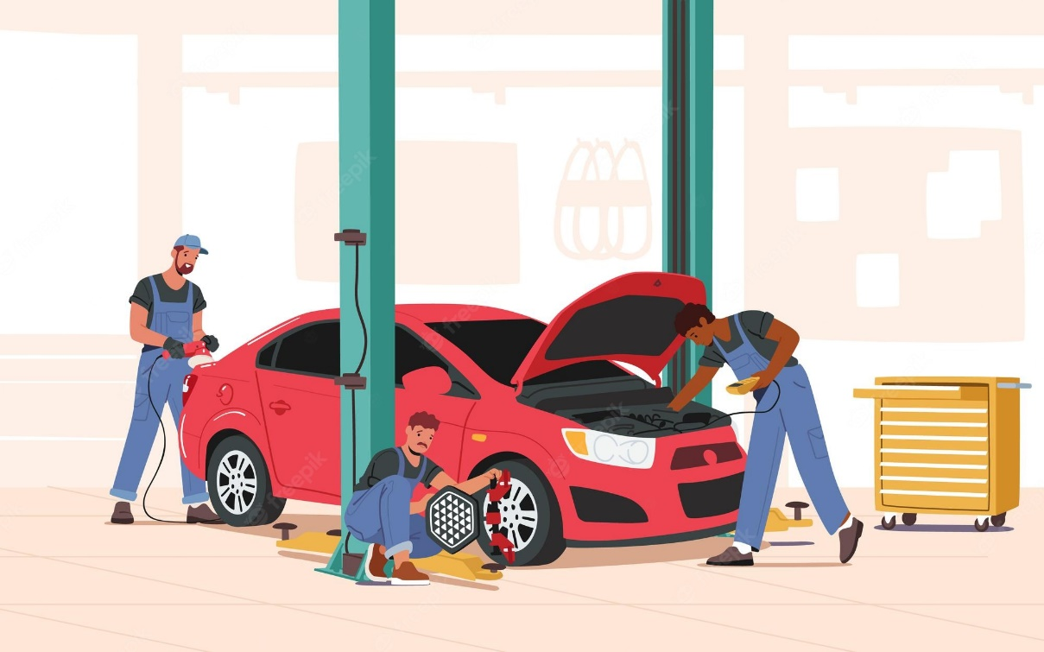
Vehicle Maintenance and Repair Services (#15722)

Slide 2
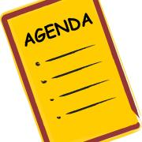
Agenda
Introductions
Enterprise Services overview
Vehicle Maintenance and Repair Services
Current
Timeline
How to get updates
Resources: How to Prepare
WA state Recognized Businesses

Slide 3
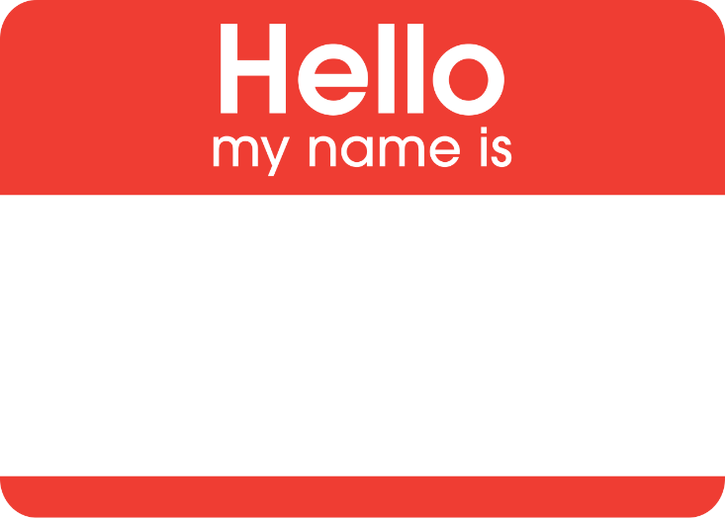
Introductions
Please rename yourself in the Participant list.
First and Last Name, Business Name, (City/Town)
Notes:
Introductions-
Please take a moment to Rename yourself in the Participant list. (First and Last Name, Business Name, City/Town)
If small group, have everyone introduce yourself, your organization name
1)I will introduce myself,. My name is Breann Aggers, and I am a Specialist with Department of Enterprise Services in Olympia, WA. I am managing this current contract, and will be resoliciting this contract in 2021.
2) I would also like to have my coworkers from DES introduce themselves. They are here to help me present, and to answer questions about the previous contract and DES. Ashly McBunch, and Erin Lopez, Can you quickly introduce yourself?
3) Read out loud participants if they have not introduced themselves.
Share Results

Slide 4
DES Contracting
Authority to create statewide contracts for the state
Procurement bridge between purchasers and contractors
What does DES and Washington State buy?
Notes:
DES procures in two main areas
Good and services contracting: DES oversees state master contracts with more than 1,200 private vendors who provide more than $1 billion worth of goods and services each year. DES purchases over $100 million a year in goods and services for DES operations. This meeting is about 00918 IT Cabling, which is a Services contract.
To Do: Provide an overview of Enterprise Services’ role in statewide contracts and state procurement.
Speaking Notes:
Authority: Enterprise Services is the only agency empowered to create Master Contracts (RCW term) for use by all agencies in the state of Washington, referred to as statewide contracts.
Procurement Bridge: Enterprise Services is not the only customer for the Master Contract; Rather, Enterprise Services creates the procurement bridge – in accordance with the State’s competitive procurement code – between suppliers and customers to enable customers to acquire the goods/services they need – efficiently and cost-effectively – to perform their mission.
State Procurement Priorities: Enterprise Services implements state procurement priorities through Master Contracts such as:
Green product preferences (PCBs, recycled content, etc)
Small and veteran business inclusion preferences
Economic & Social – e.g., pay equality; wage theft, diverse subcontractor inclusion, etc.

Slide 5
Scope
Includes services needed throughout the life of a vehicle:
vehicle fluid changes
brake work
suspension work
part replacements after warranty
transmission work
body-work
and similar repair and maintenance services.
Notes:
Explain chart: majority of sales with State Agencies. Can NOT show regional spend.
average yearly spend under $5 million.
15 of 16 vendors reported sales over 3 years of contract thus far.

Slide 6
What we are planning
Award by counties
Certification

Slide 7
Solicitation Timeline
Solicitation timeline:
early spring 2023
Anticipate award:
summer 2023
Any updates visit
Check Planned Procurement webpage

Slide 8
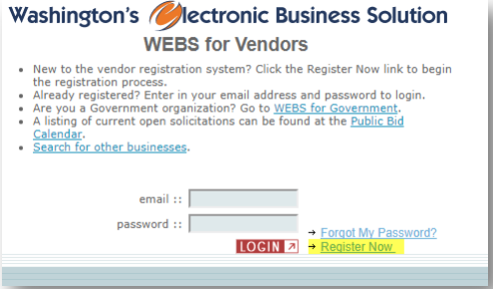
WEBS
How to register
https://pr-webs-customer.des.wa.gov/home.html
Notes:
Necessary Information: Full name, Tax Identification Number - WEBS may experience issues using the browser Google Chrome. Use Internet Explorer or Mozilla Firefox if you experience issues in Chrome

Slide 9
Step 1
Notes:
Review the WEBS Memorandum of Agreement; you cannot register unless you agree. Select “Next” to move on to the next step.
Step 1: - Fill in the account administrator’s information and company profile.

Slide 10
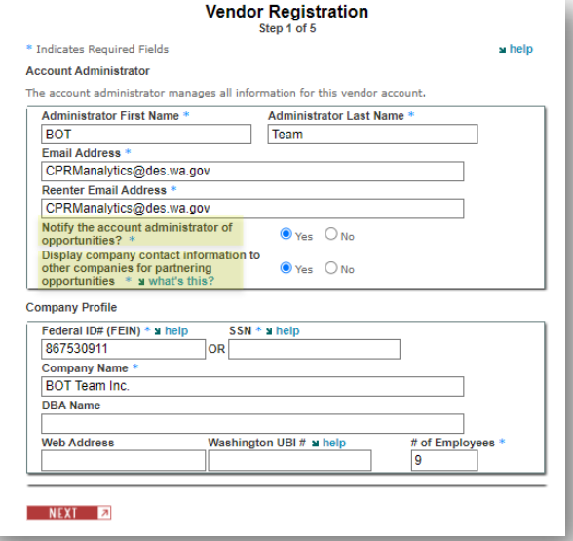
Notes:
Notify the account administrator of opportunities? This means the address entered above will receive notifications of solicitation opportunities based on the commodity codes that are selected in step 3. If you wish to turn off the notifications, go to Manage Profile & Make Changes to Profile and change this option to “No”. - Display company contact information to other companies for partnering opportunities. This function allows other vendors to search your company in WEBS and contact you for potential partnership opportunities. If you do not want other vendors to view your contact information, go to Manage Profile & Make Changes to Profile and change this option to “No”.

Slide 11
Step 2
Notes:
If you do not wish to enter your company’s ownership demographic, select “No” WEBS Manual Rev 1/9/2020 Page 6 of 21 - If you are not a small business based in Washington, select “Not a Washington-based small business”

Slide 12
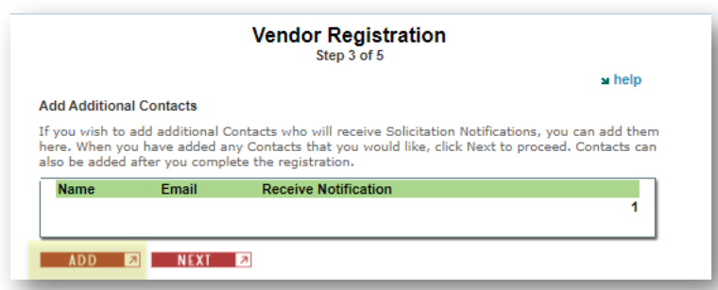
Step 3
Notes:
Add other contacts from your organization to your account. Notifications can be turned “on” or “off.” NOTE: Avoid adding the Administrator from Step 1 here. Contacts are for other users. This avoids the scenario where an Admin logs in as a Contact and sees they are not able to make profile changes. WEBS will only allow profile changes by an Admin login. The Admin will already receive notifications when the “notify account administrator of opportunities” button is set to “Yes.”

Slide 13
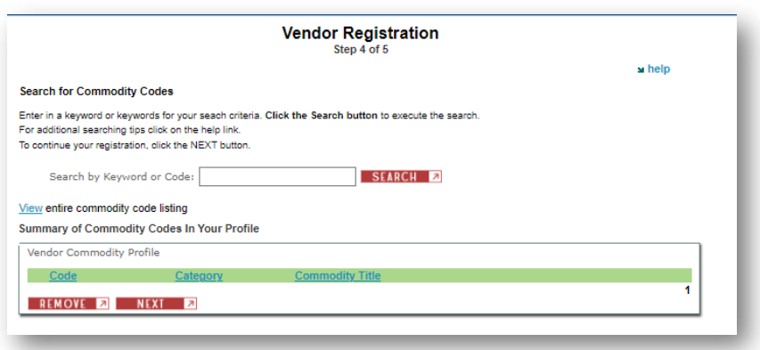
Step 4
Notes:
Type in a Commodity Code or key word that best represents your scope of work. Alternatively, view the entire commodity code list. Check the box next to the code for those that apply and select “Add” at the bottom of the page. Then select “Next.” You only need to choose one commodity code to get through registration. You can add or remove commodity codes at any time by logging in and using Manage Commodity Codes - WEBS uses the commodity code list maintained by National Institute for Government Purchasing (NIGP) and North American Industry Classification System (NAICS). - NIGP Codes are a universal taxonomy for identifying commodities and services in procurement systems. It is available as a 3-digit class code, a 5-digit class-item code, a 7-digit class-itemgroup code, and a detailed 11-digit code. - The North American Industry Classification System (NAICS) classifies business establishments for the purpose of collecting, analyzing, and publishing statistical data related to the U.S. economy. The NAICS industry codes define establishments based on the activities in which they are primarily engaged

Slide 14
Specific commodity codes
Commodity codes:
928-15 - Automobile and Other Passenger Vehicles Maintenance and Repair (Not Otherwise Classified)
928-19 - Body and Frame Work (Including Undercoating)
928-23 - Brake Maintenance and Repair
928-47- General Maintenance and Repair, Vehicle (Not Otherwise Classified), to Include Oil Changes, Lubrication, Guaranteed Maintenance Programs, etc.
928-54 - Machine Shop Services, Automotive Type (See 929-48 for Industrial Type)
928-76 - Suspension (Axles, Springs, Steering, etc.) Maintenance and Repair
928-85 - Transmission (Main, Transfer Case, Chain and Final Drives) Maintenance and Repair
928-86 - Truck and Van Maintenance and Repair (Not Otherwise Classified)
928-87 - Truck Maintenance and Repair, Heavy

Slide 15
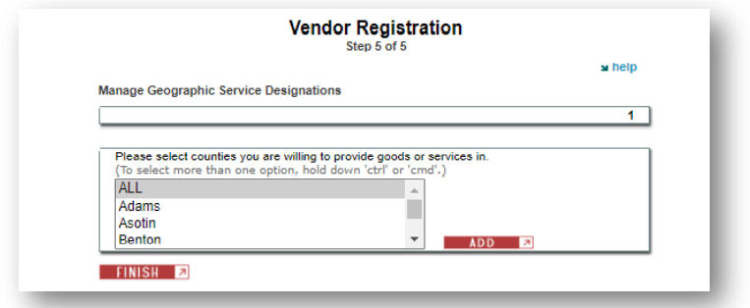
Step 5
Notes:
Select the counties in Washington State where you can provide goods and services. . Hold the “ctrl” button on your keyboard to select more than one county.
After you have completed the registration form, the WEBS team will verify your request. You will receive a confirmation email when the verification is completed. It typically takes one business day.

Slide 16
We are here to help
WEBS Registration Link
WEBS Customer Service
(360) 902-7400
WebsCustomerService@des.wa.gov
Where and how do you start?
Notes:
We are here to help.
Register for WEBS on the link provided: https://www.des.wa.gov/services/contracting-purchasing/doing-business-state/webs-registration-search-tips
Please call our WEBS Customer Service during regular business hours ((360-902-7400, WebsCustomerService@des.wa.gov)

Slide 17
Resources: How to Prepare
Register for WEBS, under at least 1 of the commodity codes listed in Vehicle Maintenance and Repair 15722 to receive notice of Solicitation Posting.
Look periodically at the Planned Procurement website for schedule updates, contract comments.
Attend Pre-Bid meeting (spring/fall 2023)
Actual Date/Time will be posted in WEBS
Get assistance from Procurement Technical Assistance Center PTAC
Notes:
I will post a copy of the slides in WEBS for folks to review/use hyperlinks
PTAC has a center in every region in the state.
Now, I am going to turn it back over to Erin, to talk about WA state recognized businesses.

Slide 18
WA State Recognized Businesses
Washington Small Businesses
Washington Veteran Owned Businesses
OMWBE Certified Firms (MBE, MWBE, WBE, CBE)
Which business designations do we recognize?
Notes:
Erin: Washington State recognized Washington Small Businesses, Washington Veteran Owned Businesses, and OMWBE Certified MWBE/CBE firms. When the state receives outside funds, additional certifications might be recognized.

Slide 19
Small Businesses
Washington Small Businesses (RCW 39.26.010)
Self-identified in DES’s Washington’s Electronic Businesses Solution (WEBS).
Attest to meeting the criteria for a small business in WEBS annually.
Washington State Enterprise
Less than 50 employees or have gross annual revenue of less than seven million dollars.
Or OMWBE certified.
Which business designations do we recognize?
Notes:
Small Businesses
Washington State Law defines small business for the state (RCW 39.26.010)
You can be recognized as a Washington Small Business by:
Self-identified in DES’s Washington’s Electronic Businesses Solution (WEBS).
Attest to meeting the criteria for a small business in WEBS annually.
These criteria are:
Washington State Enterprise
Less than 50 employees or have gross annual revenue of less than seven million dollars.
Or OMWBE certified.

Slide 20
Veteran Owned Businesses
Washington Veteran Owned Businesses: The Washington State Department of Veterans Affairs (WDVA) is the sole certifying agency for Washington State Veteran and Service Member Owned businesses (www.dva.wa.gov).
Businesses must provide:
Proof of Honorable Veteran Status
Proof of 51% ownership (or 50/50 if spousal or veteran split)
Proof the business is a Washington State Enterprise
Which business designations do we recognize?
Notes:
Washington State Veteran Owned Businesses
The Washington State Department of Veterans Affairs (WDVA) is the sole certifying agency for Washington State Veteran and Service Member Owned businesses (www.dva.wa.gov).
To become certified, Businesses must provide:
Proof of Honorable Veteran Status
Proof of 51% ownership (or 50/50 if spousal or veteran split)
Proof the business is a Washington State Enterprise

Slide 21
Minority and Women Owned Businesses
Minority, Women, and Socially and Economically Disadvantaged Owned Businesses:
The Office of Minority and Women’s Business Enterprises or OMWBE is the sole certifying agency for small businesses owned and controlled by minority, women, and socially and economically disadvantaged persons (www.omwbe.wa.gov).
Which business designations do we recognize?
Notes:
I am now going to turn it over to Caleb with the Office of Minority and Women’s Owned Businesses.
Minority and Women Owned Businesses
Minority, Women, and Socially and Economically Disadvantaged Owned Businesses:
The Office of Minority and Women’s Business Enterprises or OMWBE is the sole certifying agency for small businesses owned and controlled by minority, women, and socially and economically disadvantaged persons (www.omwbe.wa.gov).

Slide 22
Minority and Women Owned Businesses
Businesses must be:
For-profit.
A small business according to the U.S. Small Business Administration (see application information)
Eligible owner(s) must:
Be female, African American/Black, Asian America, Pacific Islander, Hispanic/Latino, Native American, Native Hawaiian, or Alaska Native
Be a U.S. citizen or legal permanent resident (federal only).
Own at least 51% of the business.
Control managerial day-to-day operations.
Have a personal net worth less than $1.32 million not including primary residence or applicant business.
Which business designations do we recognize?
Notes:
Businesses must be:
For-profit.
A small business according to the U.S. Small Business Administration (see application information)
Eligible owner(s) must:
Be female, African American/Black, Asian America, Pacific Islander, Hispanic/Latino, Native American, Native Hawaiian, or Alaska Native
Be a U.S. citizen or legal permanent resident (federal only).
Own at least 51% of the business.
Control managerial day-to-day operations.
Have a personal net worth less than $1.32 million not including primary residence or applicant business.

Slide 23
Benefits of Certification
Boosts a firm’s potential for doing business with government agencies and private companies looking for small diverse firms.
Projects funded by the U.S. Department of Transportation (USDOT), including highways, aviation, and transit, have enforceable goals for the inclusion of certified firms. Public entities that manage these projects and their prime contractors look to OMWBE’s directory for federally-certified firms.
Significantly increases a firm’s visibility through listings on important databases for certified firms.
Increases a firm’s awareness of active bids throughout the state.
Access to reduced interest rates on business loans through the Linked Deposit Loan Program (for state certified firms).
Which business designations do we recognize?
Notes:
Benefits of Certification
Boosts a firm’s potential for doing business with government agencies and private companies looking for small diverse firms.
Projects funded by the U.S. Department of Transportation (USDOT), including highways, aviation, and transit, have enforceable goals for the inclusion of certified firms. Public entities that manage these projects and their prime contractors look to OMWBE’s directory for federally-certified firms.
Significantly increases a firm’s visibility through listings on important databases for certified firms.
Increases a firm’s awareness of active bids throughout the state.
Access to reduced interest rates on business loans through the Linked Deposit Loan Program (for state certified firms).

Slide 24
Requirement Resources
Washington Procurement Technical Assistance Center (www.washingtonptac.org)
Regulatory Innovation and Assistance (www.oria.wa.gov)
What are the requirements to do business with Washington State?
Notes:
Requirements to do business with WA
Washington Procurement Technical Assistance Center (www.washingtonptac.org)
Regulatory Innovation and Assistance (www.oria.wa.gov)
Labor and Industry (www.lni.wa.gov)
Office of the Chief Information Officer (www.ocio.wa.gov)

Slide 25
Additional Resources:
WEBS
Vehicle Maintenance and Repair Services solicitation: DESContractsTeamMaple@des.wa.gov
Procurement Inclusion and Equity: Kim Sauer
Notes:
Add email and links

